Slide 1
Advocating Awareness through the Collaboration of Teachers
Youth Voter Initiative Curriculum
Advocacy Alliance Center of Texas
www.aactnow.org

Slide 2
History of Voting
The Ancient Greeks were the first ancient people thought to have practiced voting. They would meet daily in their city’s Agora to discuss relevant topics of the times. They would take a vote by a show of hands or some type of primitive ballot.
Here in the United States when our forefathers established this country, they saw to it that the Constitution had a provision for allowing citizens the freedom to vote and chose their leaders. The first voters were: men, 21 years or older, citizens of the newly established United States, and of Anglo Saxon decent. Obviously this practice was discriminatory towards women and slaves. It was not until after the Civil War that it changed. President Abraham Lincoln, who was given credit for freeing the slaves, also fought to give them voting rights. The Fifteenth Amendment to the Constitution, ratified on February 3, 1870, gave African Americans the right to vote. It would be almost 50 years later before women, through the progress of the Suffrage Movement, would be granted the right to vote.
After African Americans and women were given the right to vote, there were no changes in the voting laws until 1970 when President Richard M. Nixon was preparing for reelection in the 1972 presidential race. The issues he faced were: the prolonged continuation of the war in Vietnam, outrageous oil prices and never-ending Civil Rights violations. He felt one way to help his reelection campaign was to lower the voting age to draw votes from the younger generation. Through his efforts, the voting age was lowered from 21 to 18, and he was reelected.

Slide 3
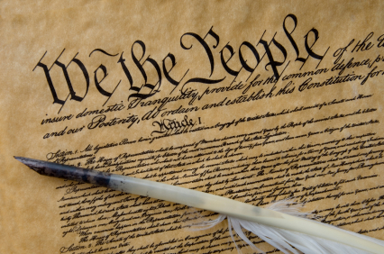
Significant documents that have influenced our right to vote as Americans
History and Background of Voting
A. European contributions
1. Magna Carta
2. English Bill of Rights
B. Early American Voting
1. Mayflower Compact
2. Fundamental Orders of Connecticut
2. United States Constitution
a. Amendment 15
b. Amendment 19
c. Amendment 24
d. Amendment 26
4. Voting Rights Act of 1965 as amended in 1970 and 1975

Slide 4
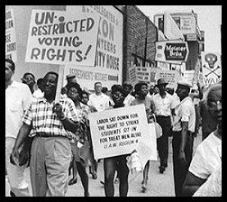
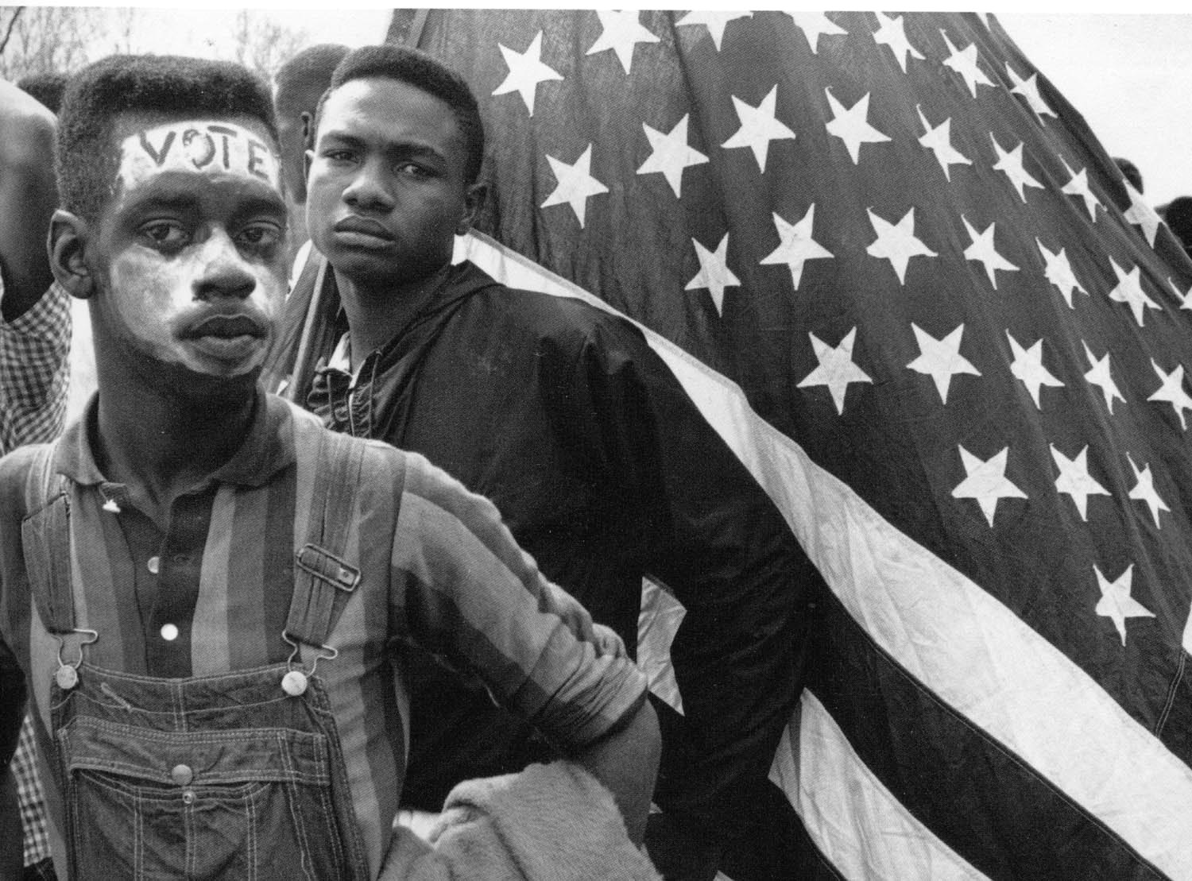
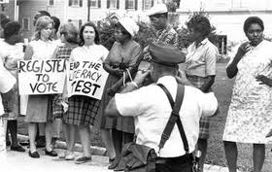
Disenfranchised Individuals and Barriers that affected Voting Rights
Disenfranchised Individuals
Barriers to Voting
LITERACY TESTS
GRANDFATHER CLAUSES
POLL TAXES
INDIANS
SLAVES
FREE BLACKS
AFRICAN AMERICANS
SMALL FARMERS IN NORTH CAROLINA
WHITE MALES IN VERMONT
WOMEN
LANDOWNERS IN MASSACHUSETTS

Slide 5
Qualifications and Requirements for Voting in Texas
Voting is a basic way to participate in a democratic government. However, many people do not vote – sometimes because they don’t know the voting process.
To be qualified to vote in Texas, a person must:
be 18 years of age or older;
be a United States citizen;
not have been determined totally mentally incapacitated or partially mentally incapacitated without the right to vote by a final judgment of a court;
4. not have been finally convicted of a felony or, it so convicted, has:
fully discharged the person’s sentence, including any term of incarceration, parole, or supervision, or completed a period of probation ordered by any court (Sec. 11.002 of Texas Election Code); or,
been pardoned or otherwise released from the resulting disability to vote;
be a resident of the county or political subdivision on the day of the election; and,
6. be registered to vote

Slide 6
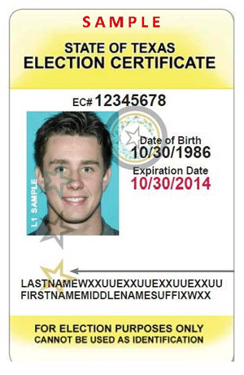
Qualifications and Requirement (cont.)
Photo Identification will now be required
when voting in elections in Texas.
Acceptable forms of photo identification (ID) to present when voting include:
(Unexpired or expired less than 60 days)
Texas Driver License
Texas Personal Identification Card
U.S. Passport Book or Card
Texas Concealed Handgun License
U.S. Military Identification with Photo
U.S. Citizenship Certificate or Certificate of Naturalization with Photo
Only individuals who do not already have an acceptable form of photo identification (ID)
to present when voting are eligible to receive an Election Identification Certificate (EIC)
at their local Department of Public Safety (DPS) Office.
To qualify for an Election Identification Certificate (EIC), applicants must be:
A U.S. Citizen;
A Texas Resident;
Eligible to vote in Texas (show a valid voter registration card or submit
a voter registration when applying for the EIC); and
Be 17 years and 10 months old or older
Residents with a documented disability may apply at their county voter registrar for a
permanent exemption from the photo ID requirement. If approved, they will not need
a photo ID to vote. Also, if individuals are voting by mail, they do not have to submit a photo ID.

Slide 7
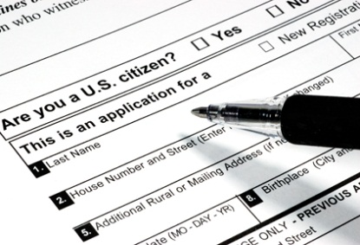
How to Register to Vote in Texas
How to Register to Vote in Texas:
Complete a post card application for voter registration and mail it postage-free, or present it in person, to the voter registrar in your county.
You may register to vote at any time, but your application must be postmarked or received by the voter registrar at least 30 days before an election in order for you to vote in that election.
You may register to vote if you are at least 17 years and 10 months of age on the date the registration application is submitted to the voter registrar, but you may not vote until you are 18 years of age.
Persons in the armed forces, or those working outside the U.S.; may register by completing a Federal Post Card Application.
As long as you remain at the address on your voter registration card, you continue to be registered.
A voter does not register as a member of a political party or as an Independent, as
some other states require.

Slide 8
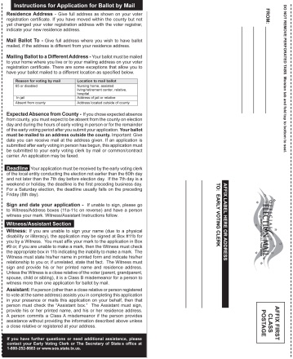
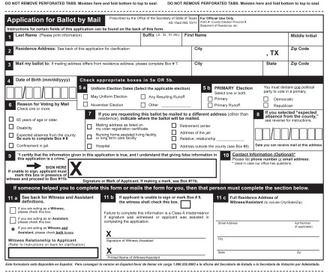
Vote by Mail
You may vote early by mail if you are:
going to be away from your county on Election Day and during early voting;
sick or disabled;
65 years of age or older on Election Day;
or confined in jail, but eligible to vote.
Applications for a ballot by mail must be submitted to the early voting clerk on or after the 60th day before Election Day and before the close of business on the 7th day before Election Day. If the 7th day is a weekend, the last day to submit an application is the preceding Friday. If you are voting early by mail, you must send your application by: regular mail;
common or contract carrier;
or FAX (if a FAX machine is available to the early voting clerk and if you are submitting your application from outside the county).

Slide 9
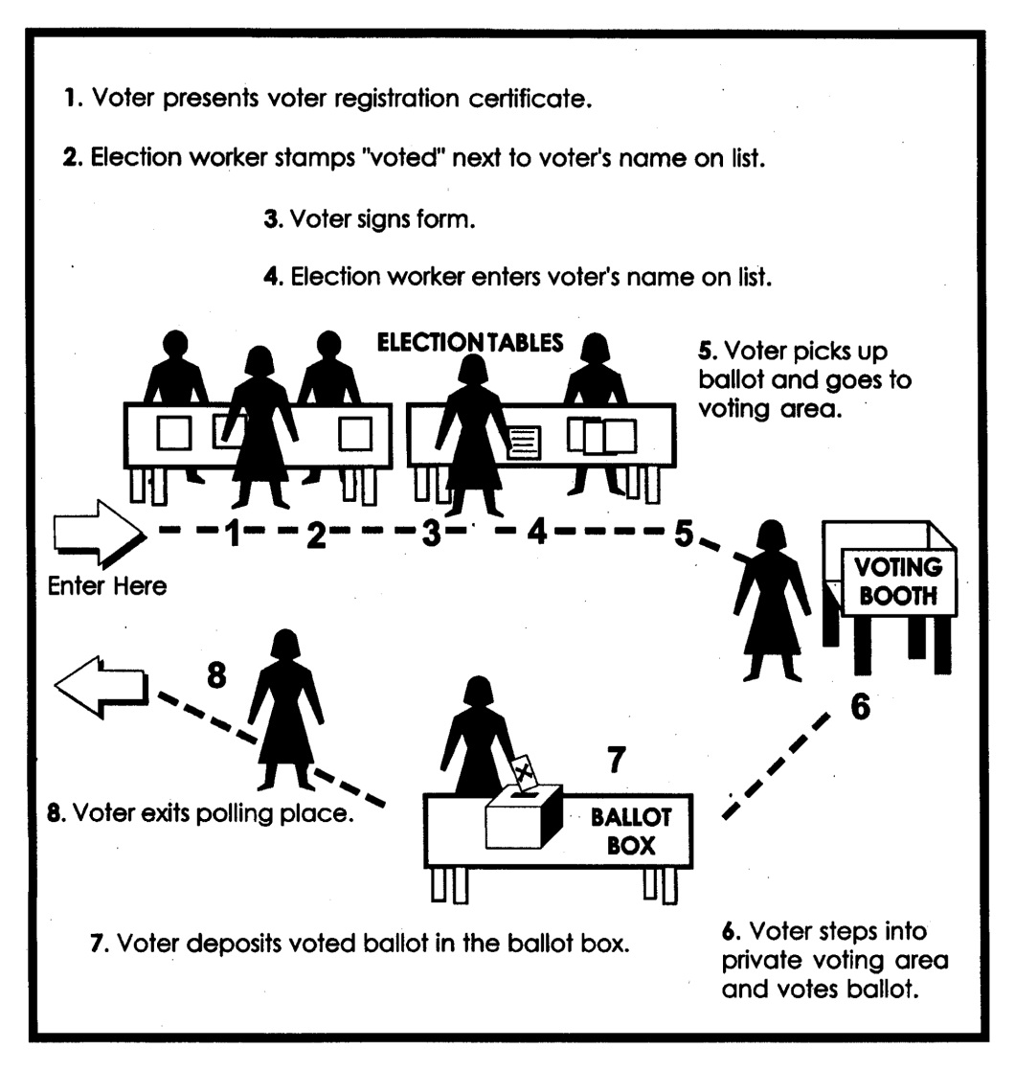
Polling Place A polling place is a location where a person goes to vote. Many times, the person votes at a school in a classroom like yours. Here is what one looks like and how a person votes.

Slide 10
Elections
Elections
Types of elections include: city elections, school district elections, community college elections, water district elections, etc., are held on Uniform Election Dates.
When are Elections?
There are two uniform election dates in Texas for political subdivisions that occur in the months of May and November. Specifically, those election dates are the second Saturday in May, and the first Tuesday after the first Monday in November. Primary, Runoff, and General Elections (These are the elections at which votes are cast for the offices of President, Governor, federal and statewide officials).
Primary Election: 1st Tuesday in March in even-numbered years. You vote in either the Democratic or Republican Primary and you would vote for federal (U.S. Senate), state (State Senate, State Representative), and county officers (County Judge, County Clerk, etc).
Runoff Elections: 2nd Tuesday in April following the primary election in even numbered years. You can vote in only one primary, and if you vote in that primary, you are entitled to vote in that party’s runoff election. If you don’t vote in either primary, you can vote in the Primary Runoff election for whichever party you chose.
General Election: 1st Tuesday after the 1st Monday in November in even-numbered years. You would vote on federal, state, and county officers in this type of an election. For example: President, Governor, U.S. Senate, State Senator, etc.

Slide 11
Importance of Voter Participation
Voter Participation
The power to govern is exercised, either directly or indirectly, through our right to vote. Your vote can make a difference. A number of critical elections would have turned out differently if just one more person in each precinct had voted the other way.
In 1800 one vote elected Thomas Jefferson president
In 1845, the U.S. Senate passed the convention annexing Texas by two votes (25-27)
In 1867 one vote ratified the purchase of Alaska
In 1920, one vote in the legislature made Tennessee the 36th state needed to ratify the amendment that gave women the right to vote nationwide.
How Important is a Vote?
We all play an important role in decisions being made. All over the world, people do not have the same rights that we as Americans. Many people in other countries just recently, as recently as 2005, are gaining the right to vote. It is imperative to get involved in the electoral process if you want to make a difference. But, in order to participate in the democratic process, you must register to vote. Come on; let your voice be heard, AACT NOW, REGISTER, AND VOTE!

Slide 12
For more information or volunteer opportunities please contact:
Advocacy Alliance Center of Texas
www.aactnow.org
612 Nolana Ave. Suite 430
McAllen, TX 78501
956.664.2228

